Slide 1


IDS WITH
Machine
Learning
Aniketh Kulkarni, Shashi Vadhan, Mohd Mustaneer Nabeel
1DT22IC004, 1DT22IC024, 1DT22IC025
Batch 5

Slide 2


Problem
Statement
  Sophisticated Cyberattacks: Growing complexity challenges traditional IDS.
  Traditional IDS Issues: High false positives, struggles with new threats.
  Project Approach: Train ML models on CSE-CIC-2018 dataset.
  Objective: Identify and use the most effective ML model/models for intrusion detection.

Slide 3

Objectve
  Develop ML-Based IDS: Use a CNN-ATTENTION-BiLSTM model and Random Forest model in hybrid architecture.
  Analyze Network Traffic: Classify normal vs. malicious activities.
  Dataset: Leverage CSECIC2018 dataset for training and testing.
  Compare Models: Evaluate performance using accuracy, precision, recall, F1-score.
  Goal: Identify and use best ML model for real-time detection with high accuracy and low false alarms.

Slide 4


Methodology
  Hybrid Model
    RF + CNN-BiLSTM-Attention
    Weighted output combination
  CNN-BiLSTM-Attention
    Detects temporal attack patterns
  Random Forest
    Fast, reliable classification
  Application
    Python-based GUI
    Live monitoring using PyShark
    Integrated SIEM dashboard

Slide 5
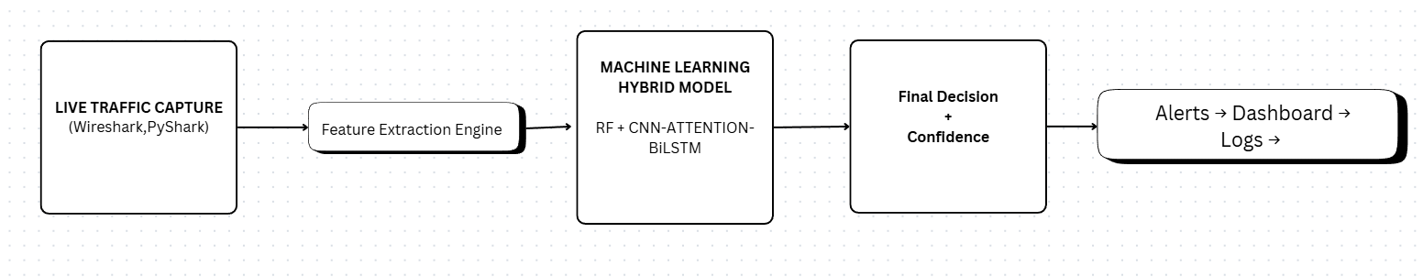
Methodology
  Solution Architecture

Slide 6
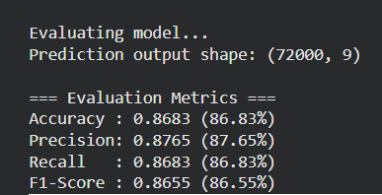
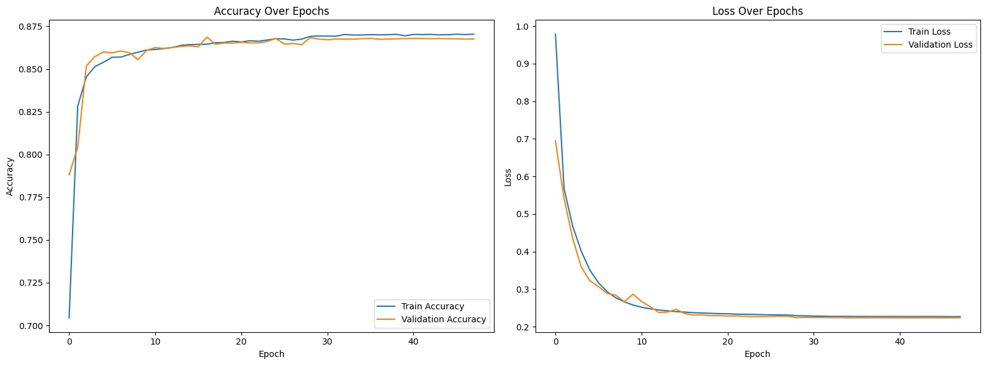
Model Training
  CNN-ATTENTION-BiLSTM

Slide 7
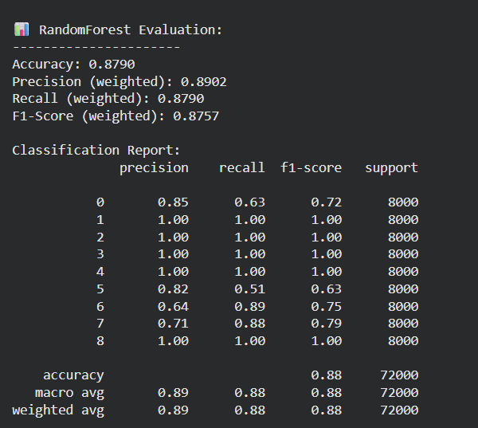
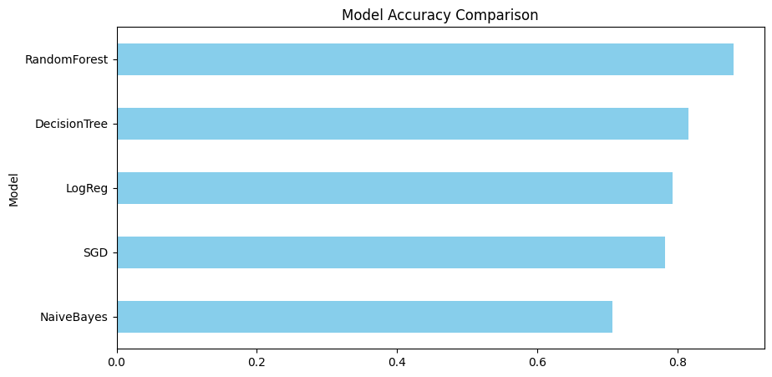
  Random Forest
Why Random Forest?

Slide 8
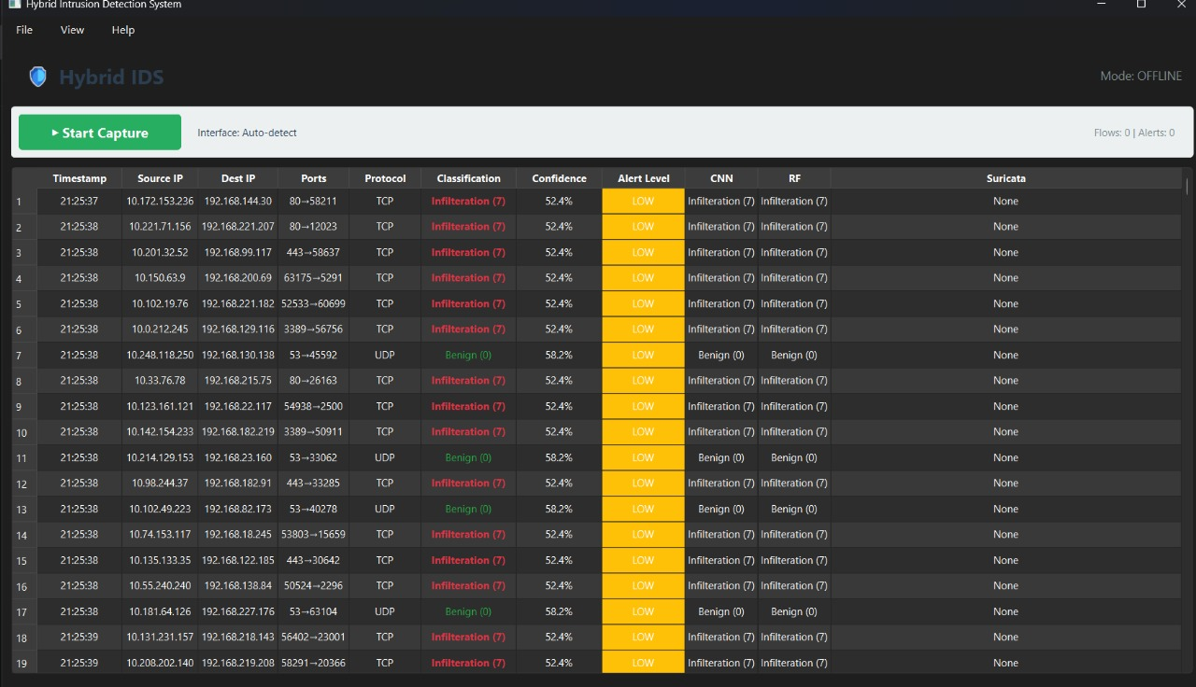
Application UI
  Real-time traffic monitoring
  Benign/Malicious classification
  Alert levels
  Flags from CNN, RF, Suricata

Slide 9


Batch 5
Thank
You

